Slide 1
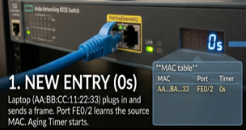
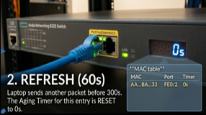
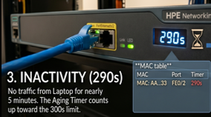
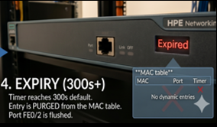
How MAC entries expires:
MAC address table expiry (aging) is the process by which a network switch automatically removes learned (dynamic) MAC address entries from its CAM table after a set period of inactivity, ensuring the table stays up to date and does not become full.
Some common Triggers and conditions:
STP Topology Change – switches typically reduce the MAC aging time (to ~15 sec by default) rather than flushing everything.
Interface Down – switch usually removes MAC entries associated with that port immediately.
Table Exhaustion – When the CAM table is full, the switch stops learning new devices and starts flooding traffic.
Manual Clear – It causes temporary flooding and relearning, then network stabilizes as the CAM table fills up again.
MAC Move – A MAC move is the switch relearning the location of a device on a new port.
Why we need this:
Mobility (handle changes)
Space Management (optimize CAM usage)
Security (limit stale/abnormal entries)

Slide 2
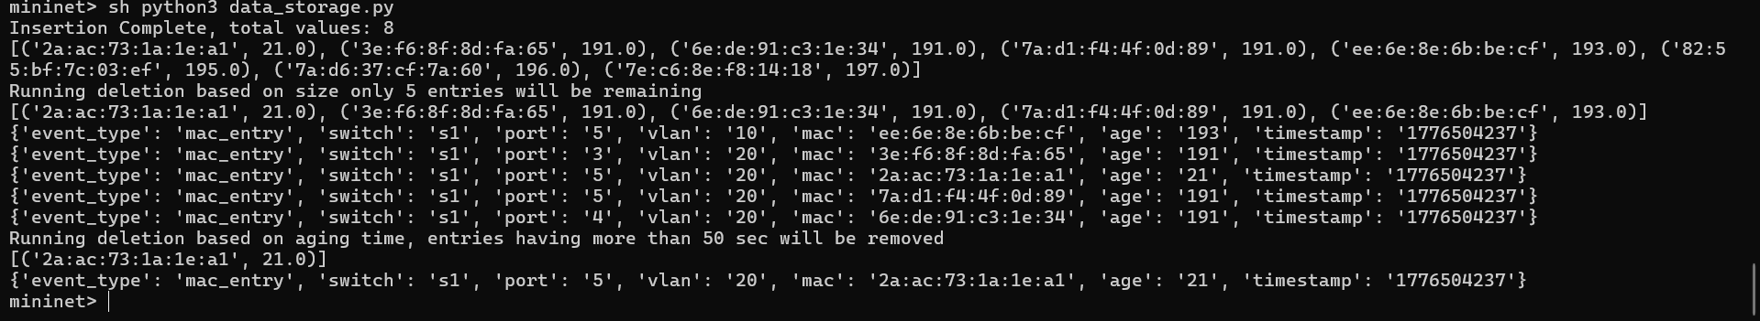
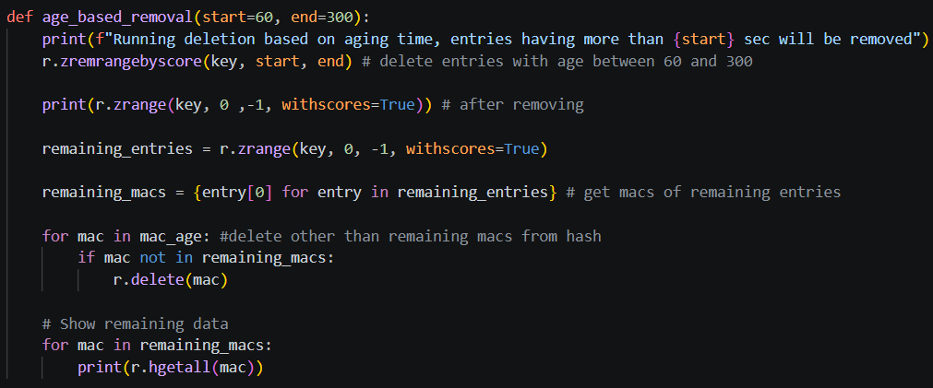
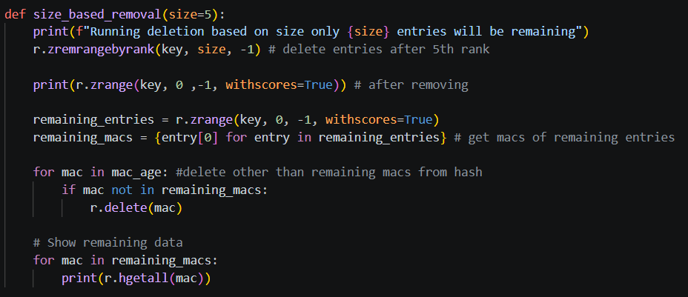
Maintaining MAC Entries:
data_storage.py is a python script will handle mac entries based on age and size of the table.
These two functions age_based_removal() – age based deletion and size_based_removal() – size based deletion, delete mac entries to maintain of mac table.

